Slide 1
Chapter 6 Software Re-Engineering & Reverse Engineering
1

Slide 2
Definitions
Forward engineering - traditional software engineering approach starting with requirements analysis and progressing to implementation of a system
Reverse engineering – system analysis process to:
identify the system's components and their interrelationships and
create representations of the system in another form or at higher levels of abstraction
Reengineering - process of analysis and change whereby a system is modified by first reverse engineering and then forward engineering.
Re-factoring (restructuring) - transformation of a system from one representational form to another
Reengineering = Reverse engineering+ Δ + Forward engineering
Δ=alterations
2

Slide 3
Forward Engineering and Reengineering
3

Slide 4
What is Reverse Engineering ?
Forward Engineering
Reverse Engineering
Requirements
Design
Source Code
Behavior
4

Slide 5
Goals of Reengineering
Port to other Platform
when platform support becomes obsolete
Design extraction
to improve maintainability, portability, etc.
Exploitation of New Technology
new language features, standards, libraries, etc.
when tools to support restructuring are readily available
5

Slide 6
Re-engineering advantages
Reduced risk
There is a high risk in new software development: development problems, staffing problems and specification problems
Reduced cost
Cost of re-engineering is often less than costs of developing new software
6

Slide 7
Reengineering Techniques
Restructuring
is the transformation from one representation form to another at the same relative abstraction level, while preserving the system’s external behavior
source code translation
Data Reengineering
integrating and centralizing multiple databases
unifying multiple, inconsistent representations
upgrading data models
Refactoring
– is restructuring within an object-oriented context
– Misuse of inheritance
change inheritance to delegation if the subclass doesn’t use attributes
Missing inheritance
duplicated code, and case statements to select behavior
– Misplaced operations
unexploited cohesion — operations outside instead of inside classes
7

Slide 8
Types of Restructuring
Code restructuring
Program transformation
Architecture transformations
Data restructuring
analysis of source code
data redesign
file or database translation
8

Slide 9
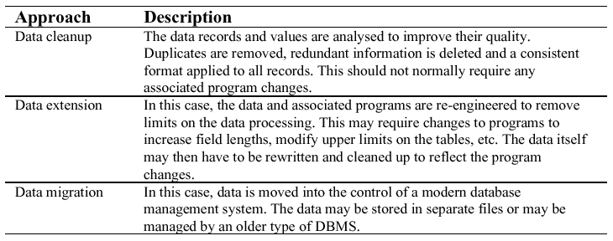
Approaches to data restructuring
9

Slide 10
Data problems
End-users want data on their desktop machines rather than in a file system. They need to be able to download this data from a DBMS
Redundant data may be stored in different formats in different places in the system
Systems may have to process much more data than was originally intended by their designers

Slide 11
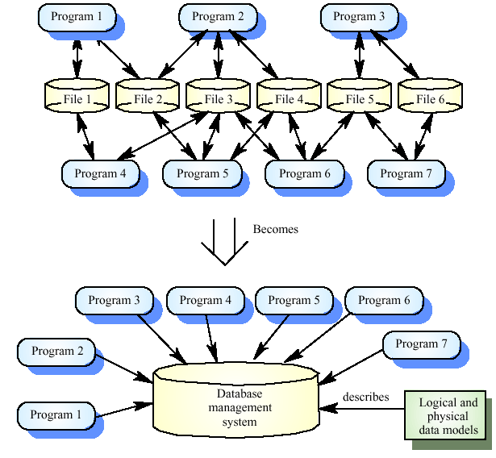
Data migration
11

Slide 12
Contd..
Data naming problems
Names may be hard to understand.
The same data may have different names in different programs
Field length problems
The same item may be assigned different lengths in different programs
Record organisation problems
Records representing the same entity may be organised differently in different programs
Hard-coded literals
No data dictionary

Slide 13
Approaches for Reengineering

Slide 14
Big Bang approach
The “Big Bang” approach replaces the whole system at once.
Once a reengineering effort is initiated, it is continued until all the objectives of the project are achieved and the target system is constructed.
This approach is generally used if reengineering cannot be done in parts For example, if there is a need to move to a different system architecture, then all components affected by such a move must be changed at once.
The advantage is that the system is brought into its new environment all at once.
The disadvantage is that it consumes too much resources at once for large systems and takes a long stretch of time before the new system is visible.

Slide 15
Incremental approach
A system is reengineered gradually, one step closer to the target system at a time.
Thus, for a large system, several new interim versions are produced and released.
Successive interim versions satisfy increasingly more project goals than their preceding versions.
The desired system is said to be generated after all the project goals are achieved.
The advantages of this approach are as follows:
(i) locating errors becomes easier, because one can clearly identify the newly added components and
(ii) it becomes easy for the customer to notice progress, because interim versions are released.
15

Slide 16
Cont’d
The disadvantages of the incremental approach are as follows:
with multiple interim versions and their careful version controls, the incremental approach takes much longer to complete; and
even if there is a need, the entire architecture of the system cannot be changed.
16

Slide 17
Partial Approach
In this approach, only a part of the system is reengineered and then it is integrated with the non-engineered portion of the system.
One must decide whether to use a “Big Bang” approach or an “Incremental” approach for the portion to be reengineered.
The following three steps are followed in the partial approach:
In the first step, the existing system is partitioned into two parts: one part is identified to be reengineered and the remaining part to be not reengineered.
In the second step, reengineering work is performed using either the “Big Bang” or the “Incremental” approach.
In the third step, the two parts, namely, the not-to-be-reengineered part and the reengineered part of the system, are integrated to make up the new system.

Slide 18
Contd..
The advantage of reducing the scope of reengineering to a level that best matches an organization’s current need and desire to spend a certain amount of resources.
A reduced scope implies that the selected portions of a system to be modified are those that are urgently in need of reengineering.
A reduced scope of reengineering takes less time and costs less.
A disadvantage of the partial approach is that modifications are not performed to the interface between the portion modified and the portion not modified.

Slide 19
Iterative approach
The reengineering process is applied on the source code of a few procedures at a time, with each reengineering operation lasting for a short time.
This process is repeatedly executed on different components in different stages.
During the execution of the process, ensure that the four types of components can coexist: old components not reengineered, components currently being reengineered, components already reengineered, and new components added to the system.
Their coexistence is necessary for the operational continuity of the system.

Slide 20
Contd..
There are two advantages of the iterative reengineering process:
(i). it guarantees the continued operation of the system during the execution of the reengineering process and
(ii). the maintainers’ and the users’ familiarities with the system are preserved.
The disadvantage of this approach is the need to keep track of the four types of components during the reengineering process.
In addition, both the old and the newly reengineered components need to be maintained.

Slide 21
Evolutionary approach
Similar to the ”Incremental” approach, in the ”Evolutionary” approach components of the original system are substituted with reengineered components.
However, in this approach, the existing components are grouped by functions and reengineered into new components.
Software engineers focus their reengineering efforts on identifying functional objects irrespective of the locations of those components within the current system.
As a result, the new system is built with functionally cohesive components as needed.

Slide 22
Contd..
The advantages of the “Evolutionary” approach:
(i) the resulting design is more cohesive and
(ii) the scope of individual components is reduced.
A major disadvantage of the approach is as follows:
all the functions with much similarities must be first identified throughout the operational system; next,
Those functions are refined as one unit in the new system.

Slide 23
Principles of Reverse Engineering
Reverse Engineering:
Systematic process of acquiring important design factors and information regarding engineering aspects from an existing product
A process which analyses a product/technology to find out the design aspects and its functions
A kind of analysis which engages an individual in a process of constructive learning of design and its functionality of systems and products
23

Slide 24
Reverse Engineering
Goal: to facilitate change by allowing a software system to be understood in terms of what it does, how it works and its architectural representation.
Objectives:
to recover lost information,
to facilitate migration between platforms,
to improve and/or provide new documentation,
to extract reusable components,
to reduce maintenance effort,
to cope with complexity,
to develop similar or competitive products.
24

Slide 25
Reverse Engineering Concepts
Abstraction level
ideally want to be able to derive design information at the highest level possible
As the abstraction level increases, the software engineer is provided with information that will allow easier understanding of the program.
Completeness
level of detail provided at a given abstraction level
As the completeness decreases as the abstraction level increases
Interactivity
degree to which humans are integrated with automated reverse engineering tools
as the abstraction level increases, interactivity must increase
25

Slide 26
Contd..
Directionality
one-way means the software engineer doing the maintenance activity is given all information extracted from source code
two-way means the information is fed to a reengineering tool that attempts to regenerate the old program
Extraction of abstractions
meaningful specification of processing performed is derived from old source code
26

Slide 27
Reverse Engineering Activities
Understanding process
source code is analyzed to at varying levels of detail
to understand procedural abstractions and overall functionality
Understanding data
internal data structures
database structure
Understanding user interfaces
what are basic actions processed by the interface?
what is system's behavioral response to these actions?
Reverse Engineering Techniques
Re-documentation
Design recovery
27

Slide 28
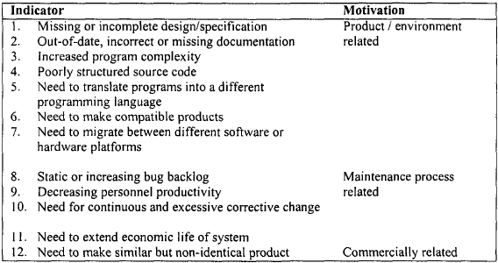
Factors that Motivate the Application of Reverse Engineering
28

Slide 29
Benefits of Reverse Engineering for Software Maintenance
Corrective change:
abstraction of unnecessary detail gives greater insight into the parts of the program to be corrected
easier to identify defective program components and the source of residual errors
Adaptive/perfective change:
Eases understanding of system’s components and their interrelationships, showing where new requirements fit and how they relate to existing components
Extracted information which can be used during enhancement of the system or for the development of another product

Slide 30
Reverse Engineering Tools
The process of reverse engineering is accomplished by making use of some tools that are categorized into debuggers or dis-assemblers-
Disassemblers – A disassembler is used to convert binary code into assembly code and also used to extract strings, imported and exported functions, libraries etc.
The disassemblers convert the machine language into a user-friendly format.
Debuggers – This tool expands the functionality of a disassembler by supporting the CPU registers, the hex duping of the program, view of stack etc.
Using debuggers, the programmers can set breakpoints and edit the assembly code at run time.
Debuggers analyze the binary in a similar way as the disassemblers and allow the reverser to step through the code by running one line at a time to investigate the results.

Slide 31
Contd..
Decompiler- A decompiler represents executable binary files in a readable form.
More precisely, it transforms binary code into text that software developers can read and modify.
The software security industry relies on this transformation to analyze and validate programs.
The analysis is performed on the binary code because the source code (the text form of the software) traditionally is not available, because it is considered a commercial secret.
31

Slide 32
Thank You

